Slide 1
CS311 Project 2 Process Document
{Ethan Buckner}
{ link to your live project }
{ link to your github repo }

Slide 2
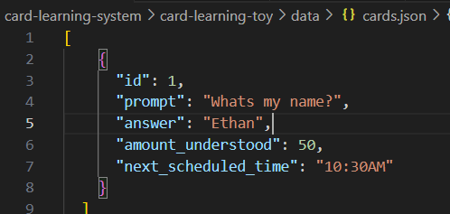
Milestone 1
By now you should have:
JSON data begun
-JSON very basic version is complete!
Pages / routes established
-Start of card subfolder and assets touched!
Outline for pages finished
-Outline is written out on paper inside my notebook!
Data loading and displaying
-Briefly touched on this, not a lot of IO created it’s one of the components I still need to begin implementation on!

Slide 3
M1 Discussion
With a partner, answer these questions about your projects, summarize your discussion here.
My data structure is okay so far, I need to include more parameters and ways to change and use the data with the cards.
When designing for mobile layouts, what CSS styles should you focus on?
what
How do you keep routes and pages “neat” when working in a multi-page site?
I created a ‘pages’ subfolder that has all my other subsites inside, I also keep the map of how I want the card site to look like near me while working on the project!
What is lacking in your user interface for understandability and use?
Actual manipulation of the card and implementation of how good you are at remembering said card

Slide 4

M1 Reflection
Please record what you are struggling with, what makes more sense now, what you need to focus on next
I’m struggling with how to traverse the different subsites inside a different directory, and how that stuff works.
I find the return statement on the main page to be less confusing, but only slightly.
I still don’t know the entire topology of React.js and how to works, and I’m finding it really hard to wrap my head around how the different sites work with each other, also how layout.tsx and page.tsx are different.
I planned on focusing my attention to IO development now, I don’t have much written down on how I’m gonna do that but have a slight idea of what I want to do.
How do I fix this?

Slide 5
M1 Self-assessment
Bold your self-assessment understanding/mastery on these areas:
Page layout standards: low medium excellent
Routing application: low medium excellent
Code cleanliness: low medium excellent
Data accessibility: low medium excellent

Slide 6
Milestone 2
By now you should have:
Buttons / interactivity completed (Check)
Timing / understanding algorithm implemented (a little less than what I want but check)
Overview page complete (…what does this mean?)
Input page begun (Starting to begin documenting what the purpose of the cards are and how they plan on bouncing off each other!
Already run / plans for user test (User tests run fine right now, after adding different types of Uis, I will start another round of tests for the user.)

Slide 7
M2 Discussion
With a partner, answer these questions about your projects, summarize your discussion here.
Difficulties sorting cards to display in a list of “most relevant”
+ I think placing the cards down onto a page.tsx is easy, the more difficult part of this assignment was the algorithm on how the ‘learning percentage’ would work, and how we can list out the cards in an order of which ones you know more going first.
User testing struggles – how to structure, what questions to ask
+Only one card at a time, simple questions at the start, but should get more difficult the more cards you read.
Routing and layout concerns
+Will I have enough room to lay out all the cards? I want to include a feature where you have the option between looking at one card at a time, or you can lay them all out, but how will I implement that is a question that I still ponder.

Slide 8
M2 Reflection
Please record what you are struggling with, what makes more sense now, what you need to focus on next
+So as of today, I am struggling with the algorithm creation, and getting the Json files to load properly, also I was confused about including SQL databases in this project, would you like us to that with this project or only for Project 3?
+Some things that make sense to me right now, would be things like the layout of how react- next.js and how the files work off each other. After learning the difference between next and react, I feel like I can look up a lot of information that I couldn't before reliably without the fear of using outdated information.

Slide 9
M2 Self-assessment
Bold your self-assessment understanding/mastery on these areas:
Page layout standards: low medium excellent
Routing application: low medium excellent
Code cleanliness: low medium excellent
Data accessibility: low medium excellent

Slide 10
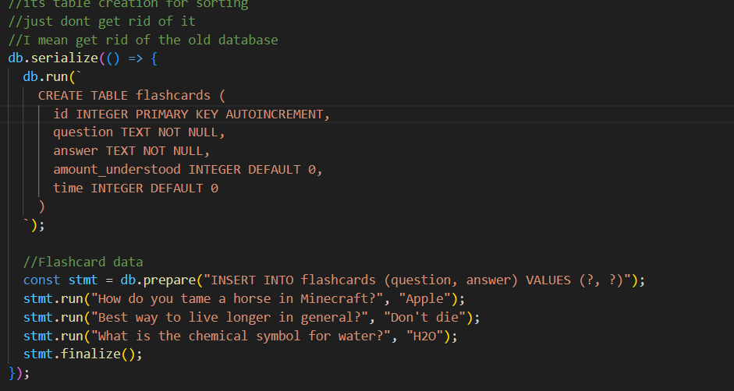
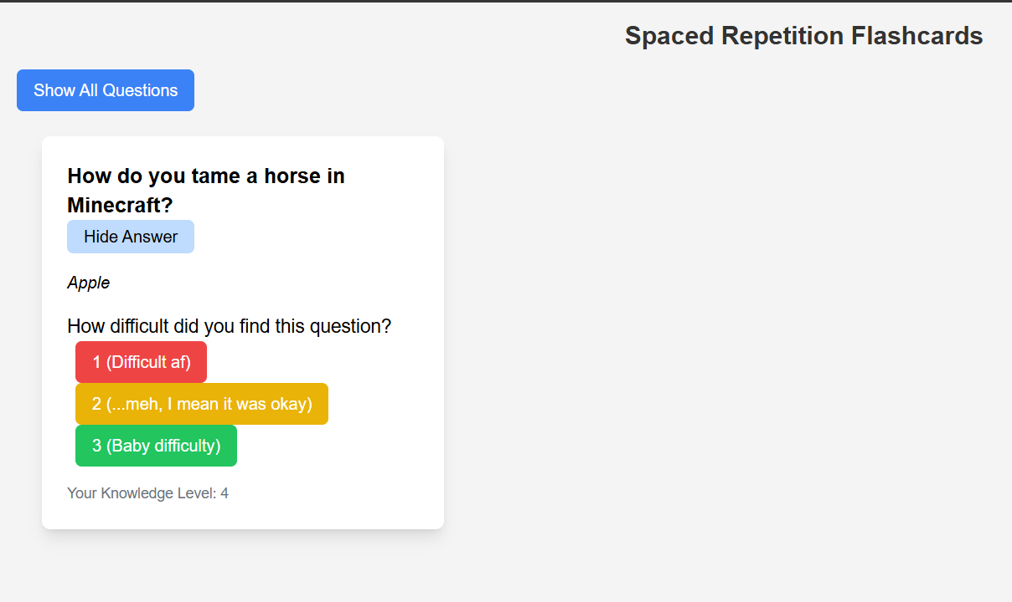
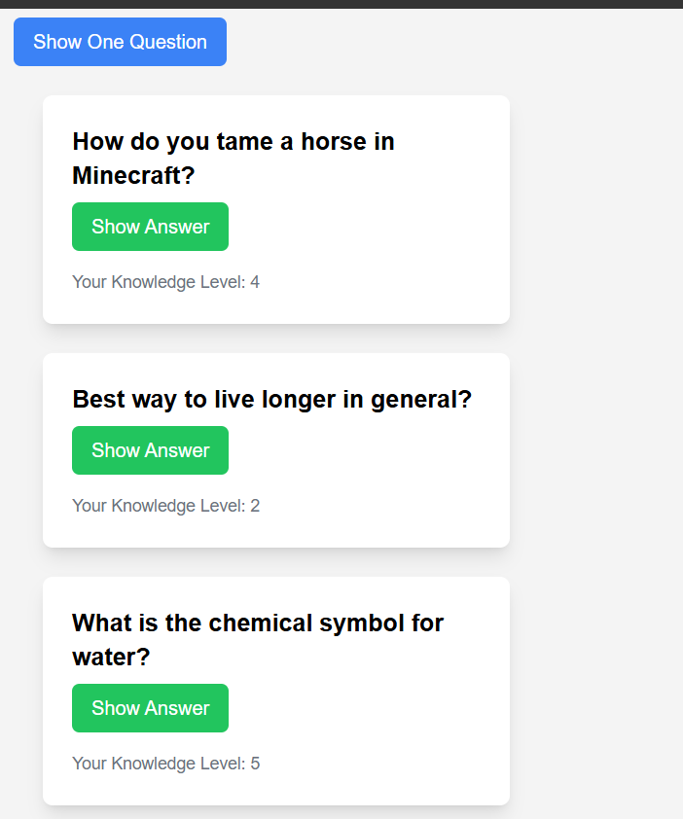
Final Deliverable

Slide 11
Final reflection
I struggled a lot with actual database creation and modification. Also with setting up everything, Vercel was very hard to understand how to use but I ended up finagling it to work with me, and then using SQLite as a way to store data was difficult work, but also a nice switch up than just using Vercel. Working with SQL was challenging but fun in the end.
Another note was how difficult the “knowledge_score” was to implement, and how to print it off with all the other cards in a table view.
Glad I got everything done though, this was a fun project!

Slide 12
Final self assessment
Bold your self-assessment understanding/mastery on these areas:
Page layout standards: low medium excellent
Routing application: low medium excellent
Code cleanliness: low medium excellent
Data accessibility: low medium excellent

